Slide 1
Stock Robo Advisor
By: Aaryan Nagaria, Atlas Metin, Kathryn Benincasa, Krishna Srinivasan, and Lucas Sohn

Slide 2
Original Model
The original stock robo advisor model used an ARIMA model as well as the yfinance package. It did not deal with outliers adequately and struggled with minimal stock metrics and accuracy. It also uses past or present data to predict future data and compare it to actual values.

Slide 3
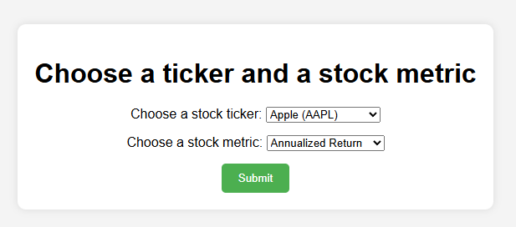
Advancements
Before
After
There was minimal data exploration available, a greater tendency for inaccuracy, no user feedback or integration, and no user interface for our model.
There are far more metrics for data exploration, our model is far more accurate and able to predict future stocks due to the IQR method and ARIMA, allows users to give feedback that strengthens the model, and has a user interface for ease of use.

Slide 4
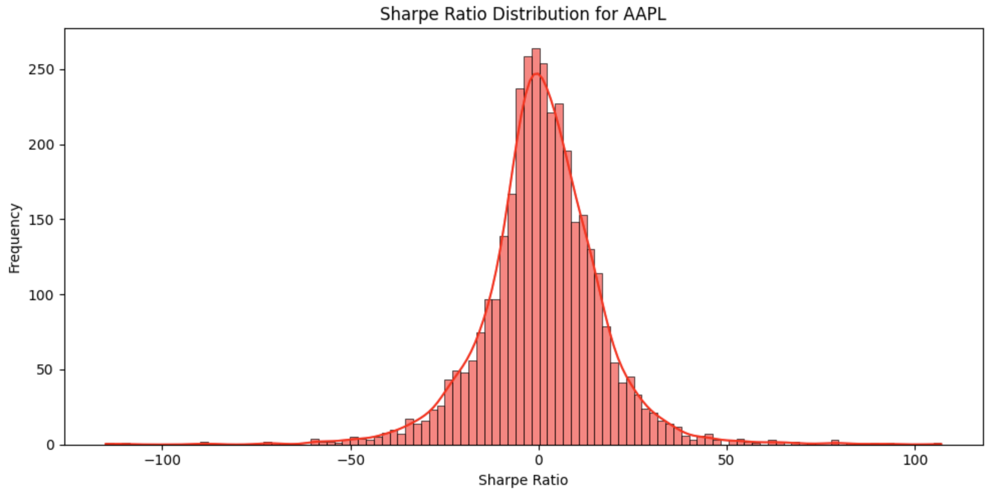
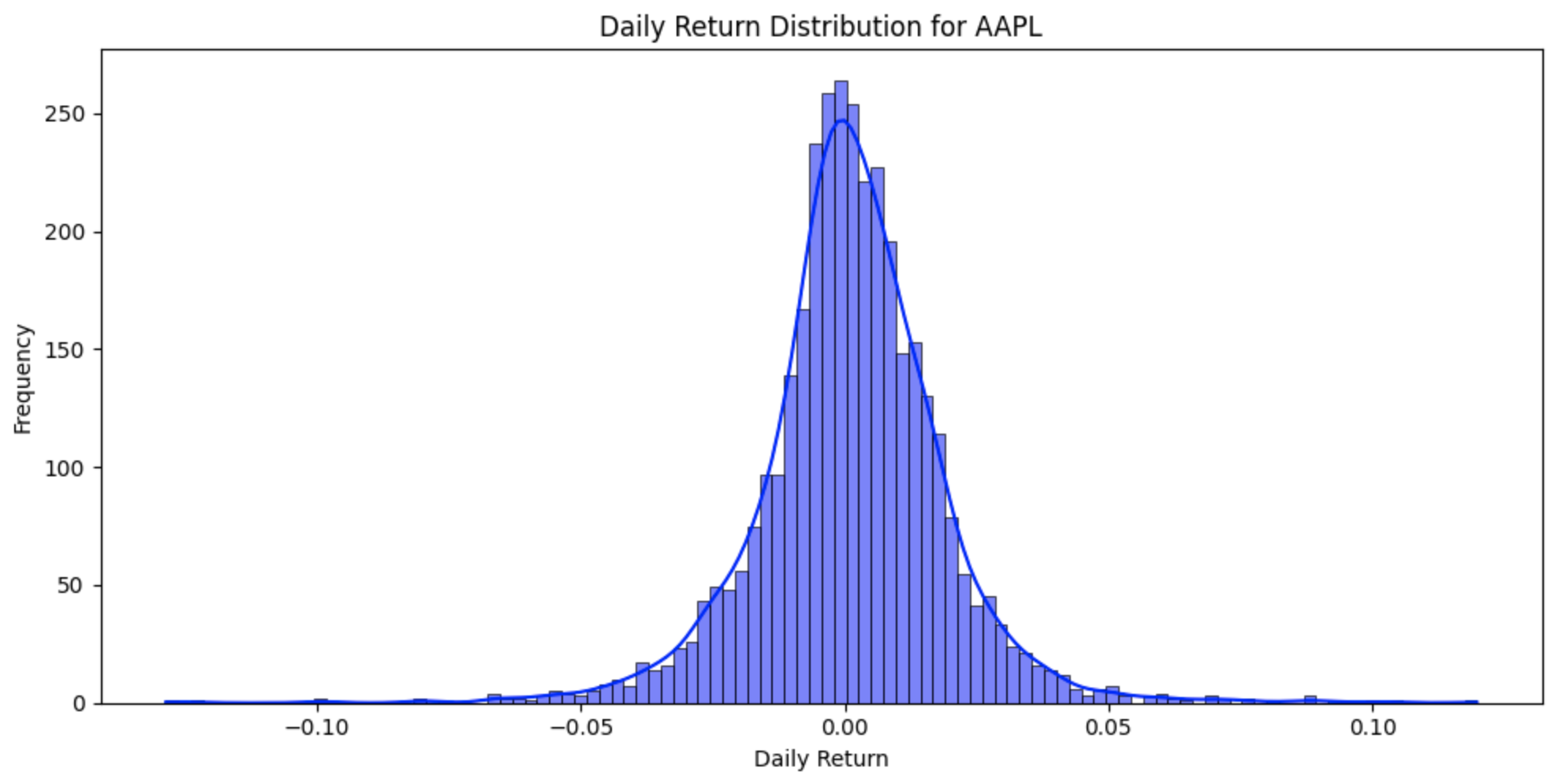
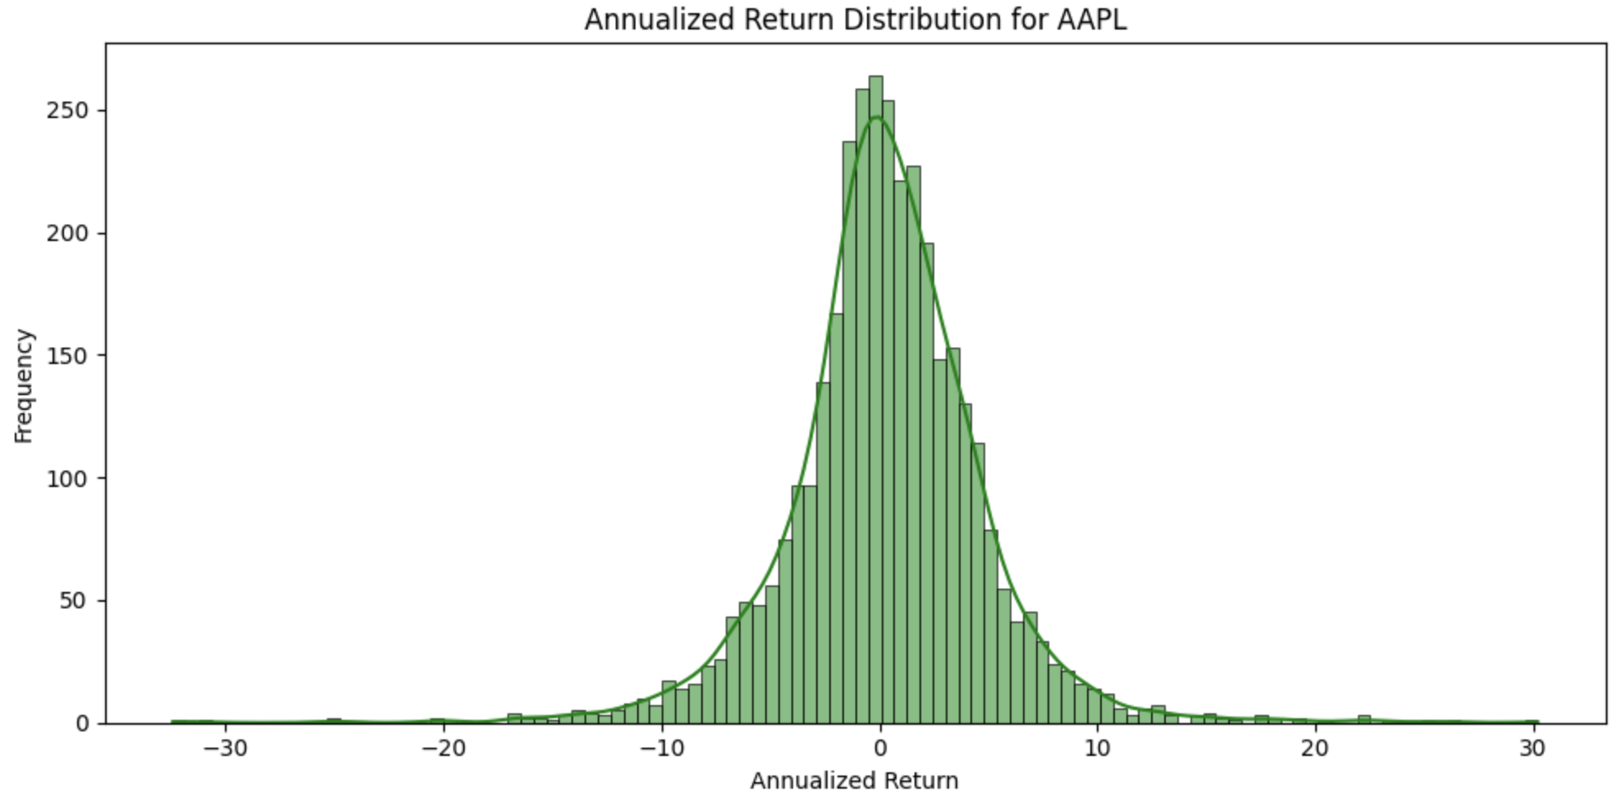
Findings from Data Exploration
Calculated the daily returns, annualized return, annualized volatility, and sharpe ratio of the stock
The sharpe ratio distribution illustrated the risk-adjusted return of the stock
The daily returns distribution showed the frequency of daily gains and losses of the stock
The annualized returns distribution helped understand the average yearly performance of the stock

Slide 5
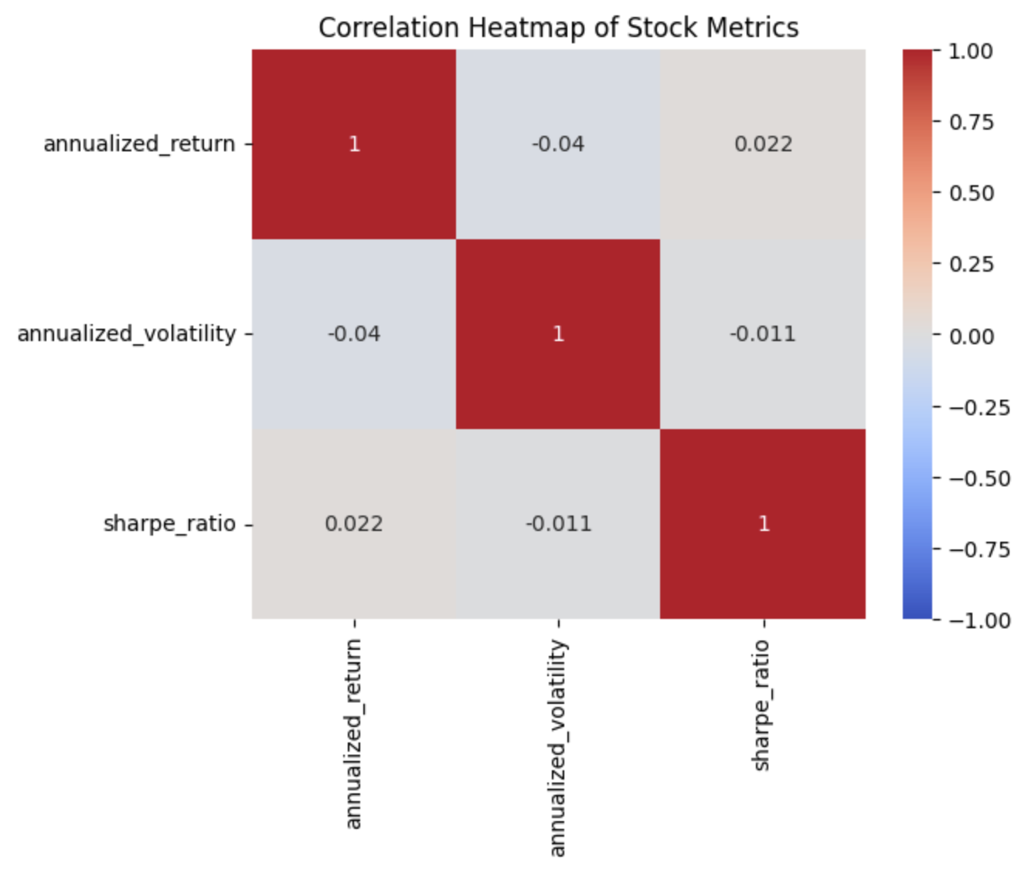
Findings from Data Exploration
The heatmap displayed the correlations of strength and direction between stock metrics
There is a very weak correlation between annualized return and annualized volatility
There is a very weak correlation between annualized return and sharpe ratio
There is a very weak correlation between sharpe ratio and annualized volatility

Slide 6
Differencing of Clustering Methods
K-Means
Cluster Analysis
K-Means divides data into discrete groups or clusters according to their commonalities or similar characteristics. It reduces variation among these clusters by constantly adjusting the center or centroid value. In this context, it partitions the data into “n_clusters”.
Cluster Analysis is done in order to view the similarity between clusters and groups in our data, this is done through a graph.
Notes:
Suggested for K-Means explanation: A well-liked technique for data clustering, K-Means divides data into discrete groups or clusters according to their commonalities. Assigning data points to the closest cluster center is how K-Means begins with a predetermined number of clusters. The variation within each cluster is reduced by repeatedly adjusting these centers. K-Means is better at locating spherical clusters in well-separated data than other techniques. Although its efficiency and simplicity make it popular, it may not work well with complicated datasets when the number of clusters is unknown or poorly defined. In our code, it partitions the data into “n_clusters.”

Slide 7
User Feedback
How it is Implemented
Benefits
User Feedback was implemented by introducing a rating system in which the user rated the recommendation given by the program on a scale from 1-10. After this, the user feedback was stored in a list which could be used in the future to modify the program so that it may accustom more of the users’ needs.
The benefits of this user interaction is that it allows us to understand what the user experienced from the model’s prediction. And using this data, we can modify our model to make it as accurate as can be and further improve the experience for future users.

Slide 8
Future Additions
Further ARIMA Training
User Review System
By introducing more training data, variables, and aspects to our code, ARIMA will only continue to grow and improve its predictions, leading to a more accurate and functional model overall.
In combination with further training, having a system where users can leave reviews can allow us to specifically know what our model needs to improve on. And it also allows the users to go into more depth on what they want out of the model compared to just a rating from 1-10.

Slide 9
Thanks!

